Slide 1
Newcastle Disease in Poultry
ND is caused by a virus called as Avian Paramyxovirus.
Classification of The Virus: Avian Paramyxovirus (APV) belongs to the genus Ortho AVULAVirus that belongs to the Subfamily Avulavirinae That belongs to Family Paramyxoviridae that in turn belongs to the order Mononegavirales.
Genra Ortho AVULA virus which is commonly known as APMV is further divided into Twenty subtypes from 1 – 20 commonly known as APMV-1 to APMV-20.
APMV-1 is further divided into Two classes
Class-I 2) Class-II
Class-II: Class-II contains both loNDVs and vNDVs. This class contains Eighteen Genotypes from I – XVIII.
Class- I: No more divided into further genera’s and contains all loNDVs for different avian specifies.
www.poultryconsultantfirm.com

Slide 2
APMVI – Class II
Geno Types | Sub Geno Types | Region of occurance | Virulence
I | Ia, Ib, Ic | Australia, Africa, Europe, US, Asia | Apathogenic, Ulster, V4
II | --------- | North and South America, Africa, Asia and Europe | Avirulent, lentogenic, Lasota, B1
III | ---------- | Japan and Australia, Taiwan, Zimbabwe | Ancient strains but still emerging, mesogenic Mukteshwar
IV | --------- | Europe, Africa, India | Virulent, Herts (UK), Texas (US)
V | Va, Vb, Vc, Vd | South America, Europe and Africa | Virulent, Anhinga (US)
VI | VIa, VIb,VIc, VId, VIe, VIf, VIg, VIh, VIi, VIj,V1k | Europe, Asia, Africa, South America | Pigeon Paramyxovirus
VII | VIIa, VIIb,VIIc, VIId, VIIe, VIIf, VIIg, VIIh, VIIi, | Emerged in Far East in 1990, Spread to Europe and Asia, Africa | Virulent,
VIII | ---- | South Africa, Asia | Highly virulent, AF22440
IX | ---- | First isolated in china in 1948. | Highly Virulent
X | ---- | Taiwan, Argentina, USA | Virulent
XI | ---- | Madagascar | Virulent, restricted distribution
XII | ---- | South America and China | Virulent
XIII | XIIIa, XIIIb, XIIIc | Asia, Europe and Africa | Virulent, Continuously emerging
XIV | XIVa, XIVb | West Africa | Highly virulent, recovered from domestic birds only
XV | ----- | China | Originated from mixed virulent and vaccine viruses
XVI | ----- | Europe in 1940s, Africa and Asia in 1980s | Highly related to genotype IV
XVII | XVIIa, XVIIb | West and Central Africa | Highly virulent, continuously emerging evolving
XVIII | XVIIIa, XVIIIb | West Africa | Highly virulent
VII a = Europe, Asia
VII b = South Africa
VII c,d,e = China, South Africa, Kazakhstan, Egypt
VII f,g,h = South Africa
VII I = Pakistan (2013)
www.poultryconsultantfirm.com

Slide 3
Classification
Mononega_Virals (Order)
ParamyxoViridae (Family)
AvulaVirinae (Subfamily)
OrthoAvulaVirus (Genus)
APMV-I -- APMV -XX (Strain/Sero Types)
APMV-I
Class-I Class-II
Class-II
Geno Types (I to XVIII)
www.poultryconsultantfirm.com

Slide 4
Avian Paramyxo Virus – I
Avian Paramyxo-I has different patho types
1). Valogenicvescerotropic: These mainly attacks on digestive system of the chicken. i.e Herts-33/56(IV), D1675/11(VII-A)
2). Valogenicneurotropic: These mainly attacks on nervous system of the chickens i.e Texas GB/48(II), D1435(VII D).
3). Mesogenic: These mainly attack on nervous system of the chicken and are less pathogenic i.e MuKtesWar (IV), Roakin (II), BeaudetteC (II).
4). Lentogenic: These mainly attacks on respiratory system and are very low pathogenic. i.e Hitcher B-I (II), Lesota (II).
5). Asymptomatic: These mainly attack on digestive system. However, are nonpathogenic. i.e Ulster-2-C (I), QV4 (I), VG/GA (II).
www.poultryconsultantfirm.com

Slide 5
Table No.1 Pathogenicity Test used to classify ND Viruses
PATHOTYPE | MEAN DEATH TIME OF EMBRYO (HOURS) | INTRACEREBRAL PATHOGENICITY INDEX | INTRAVENOUS PATHOGENICITY INDEX
Velogenic | <60 | 1.5—2.0 | 2.0—3.0
Mesogenic | 60-90 | 1.0—1.5 | 0.0—1.0
Lentogenic | >90 | <0.5 | 0.0
Symptoms of the Disease
1). With Viscerotropic Strains: depression, Conjunctivitis, Facial Swelling, Clear Mucus drop down from mouth, Gasping, Green Watery Feces, Comb wattles and Face becomes Cyanotic.
Mortality maybe 100% usually in Non vaccinated birds.
2). With Neurotropic Strains: Head or Muscular Tremors, Torticollis, Paralysis of the Wing or Legs. Typically, with nervous signs birds are alert and die because of their inability to get the feed. These kind of signs are often seen few days after infection. Mortality may reach up to 50%.
3). With Mesogenic Strains: Neurological Signs like Tremors of the Head and the Muscle Torticollis and paralysis of the wing or leg is seen. There is no or very low mortality.
4). Lentogenic strains: Slight respiratory signs are observed like gasping.
www.poultryconsultantfirm.com

Slide 6
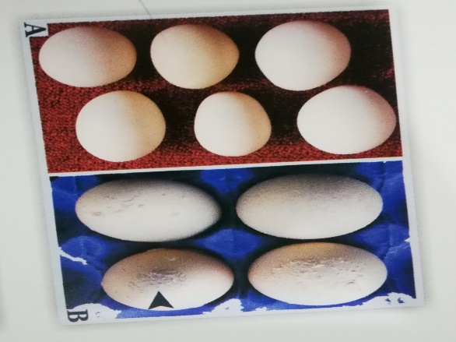
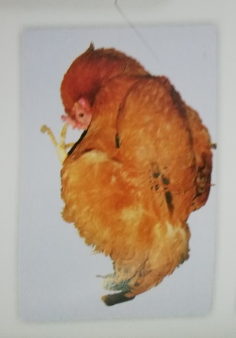
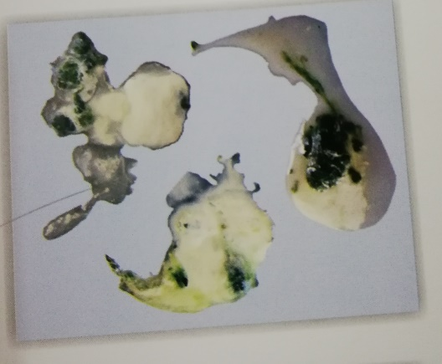
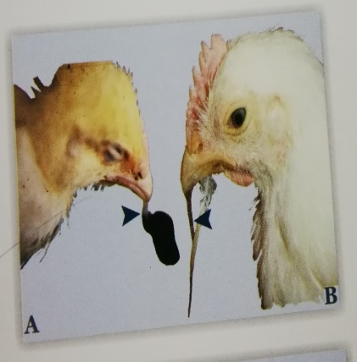
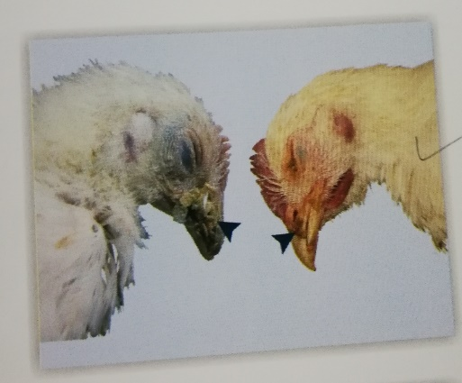
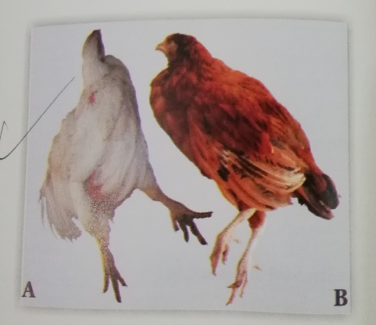
www.poultryconsultantfirm.com

Slide 7
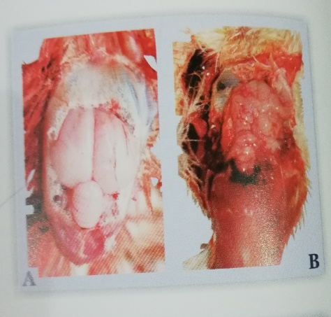
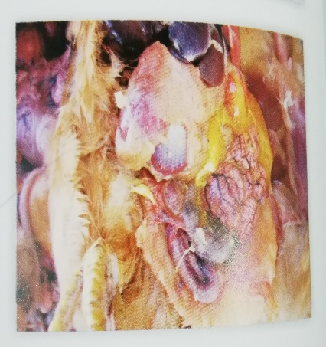
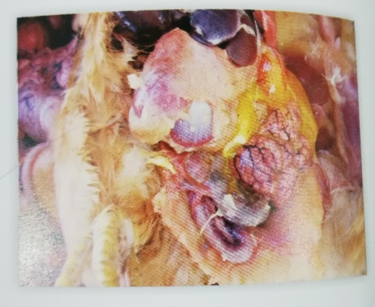
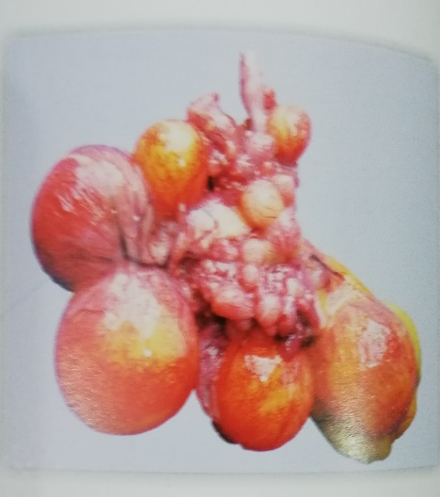
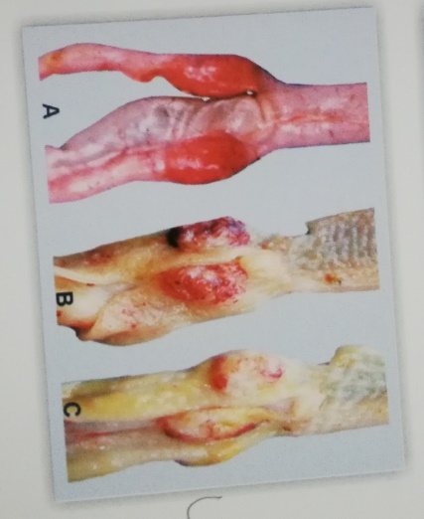
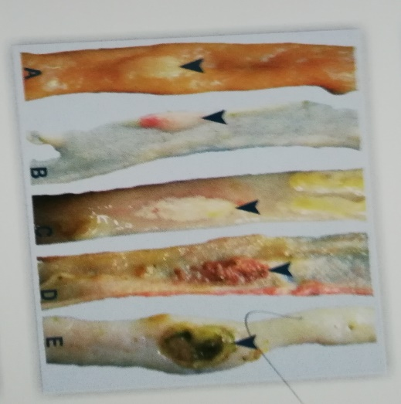
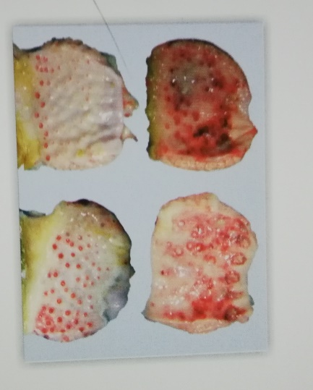
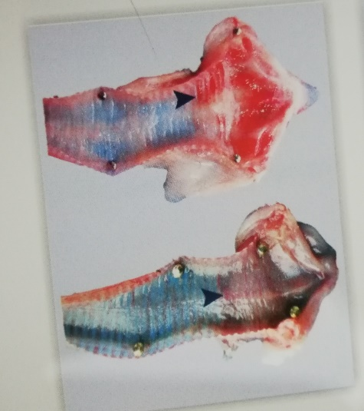
Postmortem Lesions
1). Hemorrhagic are seen in Brain, proventriculus, lower eyelid Cecal Tonsils, Thymus, spleen, Trachea, Lungs and ulcerative lesions in intestine.
2). Egg York Peritonitis, degeneration of ova and oviduct, regression of ovary.
www.poultryconsultantfirm.com

Slide 8
History:
First documented outbreak of ND occurred in 1926, in Newcastle (England) and Jawa (Indonesia).
Economic Significance:
1). Can cause 100% mortality in Non-vaccinated birds in commercial poultry and also causes enormous damage to backyard poultry.
2). At commercial level a lot of money is expended for its prevention and Control Programs.
Public Health Significance:
Causes self-limiting conjunctivitis in human also can cause flu like conditions.
Morphology:
APMV is an RNA virus. These are round in shape with diameter of 100-500nm or maybe pleomorphic. Its jenome is compose of six structural proteins.
1). Nucleocapsid Proteins (NP) 2). Phaspho proteins (P) 3). Matrix (M) 4). Fusion (F) 5). Hemagglutinin - Neuraminidase (HN) 6). RNA dependent RNA Polymerase (RNAP)/L Editing of Phaspho Proteins produce another protein called as V-protein that has anti interferon Activity
www.poultryconsultantfirm.com

Slide 9
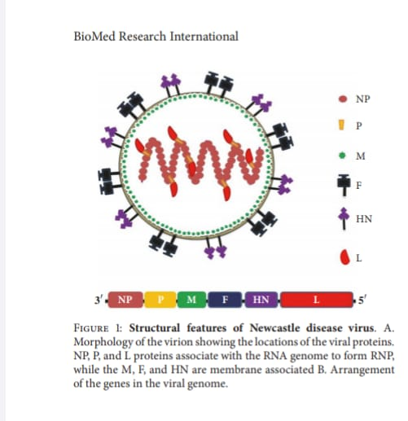
Pathogenicity: The virulence of NDV is a complex trait that is determine by multiple genetic factors. Like virus strains, all viral proteins specially F-protein. When the virus enter the body of the chickens cleavage of F-protein at cleavage site FO is the first step for the replication and activation process. It is seen that cleavage site of F-protein molecules plays extremely important rule in the virulence of the Virus. If their present monobasic Amino acid motif at the cleavage site it easily be cleaved by trypsin which is abundantly present in respiratory and digestive tract. In this case cleavage of F-protein occurs extra celullarly, this occurs with less pathogenic strains.
www.poultryconsultantfirm.com

Slide 10
However, at cleavage site if there present multi basic amino acid sequence, the cleavage cannot occur by trypsin and preferably it occurs inside the cell by Furin like proteases. This mostly occurs with virulent strains. After the cleavage replication of the virus starts very quickly and cell of the vital organs start damaging very badly.
The presence of basic amino acid at position 113, 115,116 and phenylalanine at 117 in virulent strains means that cleavage will occur interacellularly in the presence of Furan like proteases. In viruses with low virulence usually have arginine at position 114. Such viruses are therefore restricted in their range of replication site and easily cleaved in respiratory and digestive tracts in the presence of trypsin.
Summary: contribution of viral proteins in its Virulence.
Change in CPI Value
Gene
www.poultryconsultantfirm.com

Slide 11
Some observations show that lo NDA can be a real threat,
Reverse genetics shows that only three mutations are required by Lasota to change into vNDV.
Lo NDV isolates from water fowl may evolve to v NDV by passages in chick embryos.
Lo NDV is closely related to v NDV circulating in same region, there is difference of only two neocleotides at cleavage site.
Susceptibility: After removal of organic matter NDV is susceptible to Sodium Hypo Chloride, sodiumhydroxide, Glutaraldehydes, Formaldehyde, Formalin and heat.
Transmission: NDV is transmitted horizontally by contaminated, Dust, Air, Feed, Water, Cloths, Shoes, Vaccines, other poultry products, Visitors and wild Birds. There is no vertical transmission, oftenly infected embroys die during incubation. However, embroys maybe infected by contaminated feces through eggs shell cracks and newly hatched chicks by contaminated egg shells and dead embroys in hatchers.
Incubation Period: It varies from 2-15 days, on the average 5-6 days. Aerosol transmission have shorter incubation time than that from ingestion.
www.poultryconsultantfirm.com

Slide 12
Diagnosis: diagnosis is made on the basis of clinical signs and symptoms, postmortem lesions and laboratory test like PCR. For diagnosis through PCR normally tracheal and cloacal swab are taken from live birds and organ tissue samples from liver, spleen, kidney and brain are recommended.
Traditionally serology is done to determine the effectiveness of a vaccination program.
From both HI and ELISA, HI is preferred over ELISA because it detect antibodies against HN protein and ELISA is however detect anti bodies against all proteins of the Virus thus Eliza may not give conclusive idea about exact protection level.
Differential Diagnosis: ND should be differentiated from aspergllosis, mycoplasmosis, infectious laryngotracheitis, Fowlcholera, infectious bronchitis and avian influenza.
www.poultryconsultantfirm.com

Slide 13
Immunity:
1). Passive Immunity: protection through passive immunity depend upon maternal antibodies derived from egg York. However, its protection level depends upon
a). Vilulence of Virus b). Challenge Dose c). number of antibodies present at the time of infection. Level of antibodies in day old chickens directly related to titers in the parents. On average the amount of antibodies decreases by their half after every 6 days.
2). Innate immunity: Within 6 hours after infection with vNDV interferon Alpha and Beta and interleukin 6 are produced by spleen. Interferon Gamma is produced after one day and whole innate immune system of the chickens is activated within 1-2 days, that includes the production of interferons, cytokines, chemokines.
=> Activity of NK cells improves as the bird ages that provide explanation of decrease susceptibility against pathogens at late age.
3). Acquired Immunity: Interferon Gamma of CMI is produced after 3 days of infection or live vaccination that plays important role to reduce mortality and Morbality. IgM are produced 3 days after infection or live vaccination and then IgG and IgA are produced on 7 days. IgA is responsible to provide local immunity.
www.poultryconsultantfirm.com

Slide 14
Vaccination
Role of ND vaccination is to control mortality and morbality. However, vaccinated birds remain failed to protect themselves against field challenges of vNDV.
Live Vaccines: Different Apathogenic and lentogenic viruses are used in live vaccines having their ICPI level upto 0.4, like B1, LaSota, VG/GA, V4 and Ulster 2C. For live vaccines ocular route provide best take up response which is up to 93%.
While vaccines through drinking water and spray produce protective titers only in 55% birds. While applying vaccines through Aerosol or spray particle size of the vaccine play very important role if the particle size is very small then it can penetrate deep into the lung tissues and can cause severe post vaccinal reaction.
If partial size is too large, then it may drop down to the ground, resulting in reduced take up of the vaccine.
Droplet size for primary vaccination is 170-180 microns.
Droplet size of repeated vaccination is 115-120 microns.
For day old chicken aerosol route is better than drinking water. Some live vaccine with high ICPI upto 0.7 can also be used intradermally into the wing web to initiate better immunity with least post vaccine reaction.
www.poultryconsultantfirm.com

Slide 15
Live vaccine produces good local immunity and less systemic immunity. Must consider the level of maternal anti bodies while doing the live vaccinations.
Killed Vaccine: killed vaccine provide good systemic immunity and poor local immunity. However, there is no fear of interference with maternal antibodies. These vaccines are particularly used in long live birds and also for maternal transfer of immunity to new born chicks.
Recombinant Vaccine: Live vectors of fowl pox, MDV and HVT containing the segment of F-proteins of NDV have been established.
There is no fear of interference and post vaccine reaction. However, development of immunity takes 3-4 Weeks to reach to protective level so are used in combination with modified live vaccines. These provide broader range of immunity, however level of immunity is lower than that produced by the combination of killed and modified live vaccines.
Vectormune Vaccines: same technology is used in vectormune vaccines. However, there is a difference of construction of vaccine molecule in a way that F-segment is inserted in between UL-45—46 genes, while in recombinant vaccine the F-segment is inserted inside US-10 gene.
www.poultryconsultantfirm.com

Slide 16
Recent data shows that vector immune vaccines are superior than that of rHVT-ND vaccines in all aspect, like protection level against field virus (including genotypes7) control of viral sheding after field challenge, in early onset of immunity, protection against mortality and better FCR in broiler birds.
Vector mune ND vaccine is injected at hatchery along with spray of live ND vaccines. Then at the age of 15 days, second live ND vaccine is done through eye drop as booster. Protection reaches to 95% at 3 weeks and to 100% at 4 weeks.
www.poultryconsultantfirm.com

Slide 17
Current Field Observations
One study showed that hyper immune sera produced by GVII shows higher HI titers with same antigen i.e 11.1 ± .30 log2. However, showed 9.53 ± .50 log2 titers when checked by lasota antigen.
Similarly, hyper immune sera by lasota showed high titers 9.73 ± .36 log2 when analyzed by same antigen but 2 fold lower 8.87 ± .38 log2 titers when checked by opposite antigen of G-7.
The cross reactivity “R value” between lasota and G-VII found to be 0.23 indicating that these are loosely related with each other within same serotype.
Another study showed that live or killed vaccine of lasota (II) give good protection against VIg,VIb, IX and VIId.
In another study in Egypt it is revealed that genotype-II vaccine is not efficient in stopping/controlling NDV infection caused by G-VII.
www.poultryconsultantfirm.com

Slide 18
Way out
At higher administration level,
Proper selection of vaccine is key which is possible only after isolation, genotyping and sequencing of genome.
Designing the appropriate ND vaccination programe considering the level of threat of field challenge. i.e. in high challenge areas we can use killed + live vaccines in combination.
However in even more endemic areas combination of all vactormune +killed + live will give comparatively better results.
At farm level
Proper biosecurity.
Best managmental practices including good litter condition, good ventilation, clean water and feed, prevention from immunosuppression.
Best vaccine administration techniques.
May be able to control the challenge to great extent.
www.poultryconsultantfirm.com

Slide 19
Treatment
Supportive therapy is only the choice one can use to boost the immunity with multivitamins.
During an outbreak don’t hesitate to administer live vaccine (Avirulent/Non pathogenic i.e. Genotype 1 like Ulster,v4,Lasota) in apparently active looking sheds by subcutaneous route it will help the bird by immediate activation of innate Immune system by producing tons of INTERFERONS that have direct killing effect for virus and provide immediate relief to birds.
www.poultryconsultantfirm.com

