Slide 1
Infectious Bronchitis (IB)
IB is caused by a virus called as Coronavirus.
Classification
It belongs to order Nidovirales, family Coronaviriede and genus, Gamma coronavirus. On the basic of analysis on S1 gene of 1286 IBV strains, it is divided into 6 genomes from G1 to G6, G1 have 27 lineages and from genotype 2 to genotype 6 each have one lineage. So there are present 32 lineage (strains) of IB worldwide.
Order ➔Nidovirals
Family ➔Corona Viridae
Genus ➔Gamma Corona Virus
www.poultryconsultantfirm.com

Slide 2
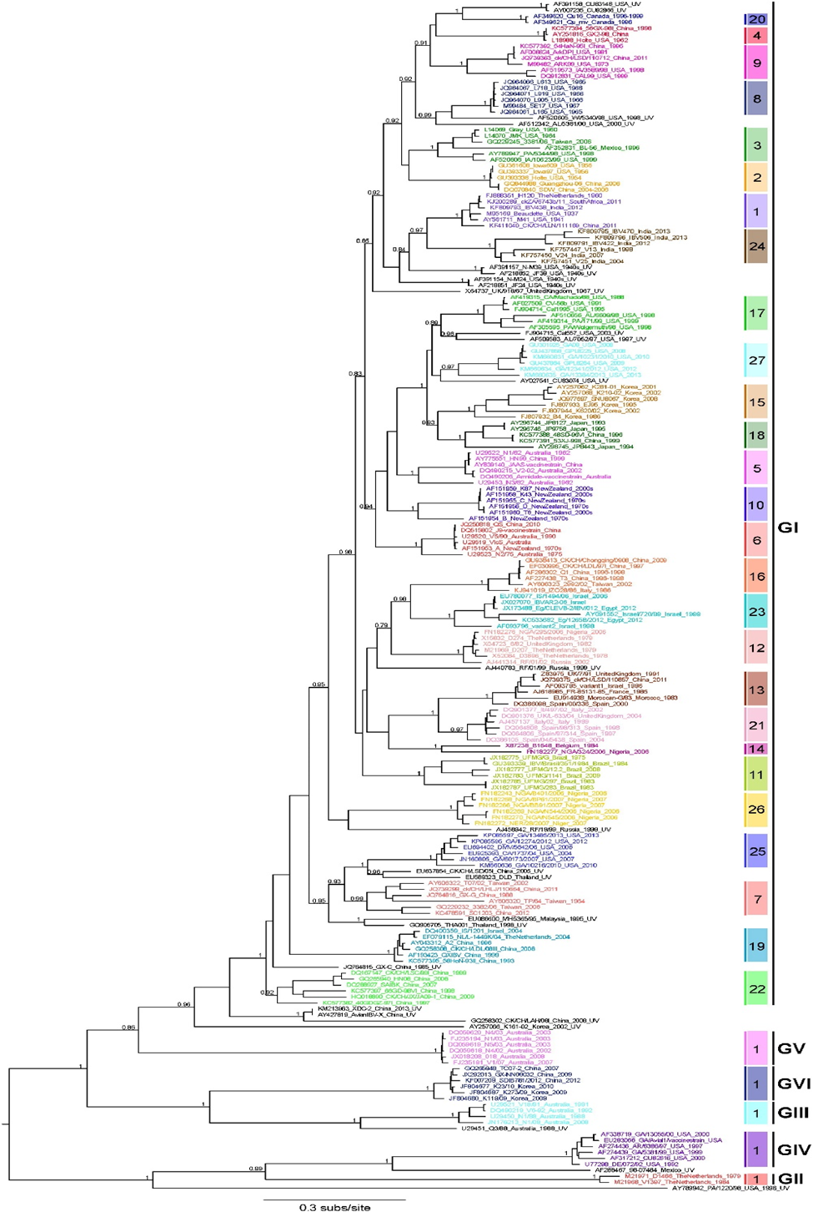
www.poultryconsultantfirm.com

Slide 3
Symptoms of the disease
In chickens with age less than 6 weeks, there is gasping, Coughing, Sneezing, Tracheal rales, Nasal discharge, Swollen sinuses, Depression, chickens huddle under the heat source. Poor FCR and weight gain is reduced also.
In chickens with age over 6 weeks, all the above mentions sign are very unclear, however some respiratory sound can be noticed while examining carefully. Sound are more clear during night time.
Broiler chicks which are infected with nephrophegenic strains may recover from respiratory signs early. However, then they show depression, ruffled feathers, wet dropping, increased water intake and more mortality. Predisposing factor for nephrophegenic strains are young age, cold seasons, bread of the chicks, high dietry calcium and high protein diet from animal by products.
In laying hens the above mentioned respiratory sign may be absent completely or present with very low severity, however there is clear drop in egg production from 5 to 70%. Egg shell become faint in color and unpigmented, abnormal shelled eggs (misshapen, thin, soft and rough shelled), watery albumen in fresh eggs, decrease in egg weight and hatchability. Flocks with falsc layer failed to get peak production and peak may remain up to 35% less than the normal peak, however flocks looks healthy, behave normal and produced good eggs. If infection occur at peak production, then there high severity of disease is observed than in flock that hit by IB after peak production time.
www.poultryconsultantfirm.com

Slide 4
The severity of the respiratory signs depends upon breed of the birds, strains of the virus, immunity level against that strains, period of the lay and coinfections.
POST Mortem Lesions
Gross Lesions
serous catarrhal or caseous exudate in trachea, Nasal passages and sinuses. Air sacs are foamy during acute infection and then onward become cloudy and can contain a yellow caseous exudate. Areas of pneumonia may be observed on the lungs. During attack with Nephrophathogenic strains kidney become swollen, pale, tubules and Ureters are distended with urates.
Cystic Left Oviduct are seen during production if birds remain unprotected during early age then it shows false layers at onset of production. Decreased weight and length of the oviduct and regression of ovaries is also observed. In recent reports proventriculitis is also seen which is associated with QX-Q1 Genotypes.
www.poultryconsultantfirm.com

Slide 5
History
IB was first observed in United States in North Dakota in 1930. The first IBV vaccine was developed in United States using Van Roekel M41 strain which is Mass Sero type. Virus isolated at the University of Massachusetts in 1941. In 1956 JUNGER reported and isolated a serotype of IBV in Connecticut that was unable to provide protection against original mass type IBV. This lead to the awareness that serotype of the virus is existing and also that they are not providing cross protection against one another.
In 1960 Winter field and Hitchner reported some nephropathogenic strains like gray and Halted.
In 1990 different strains began to identify in different laboratories using molecular techniques.
In 1960 it was discovered that IBV can interfere with the growth of NDV in embryonating eggs and cell culture. Which was significant because IBV and NDV vaccine are often being given to the birds together in the field.
www.poultryconsultantfirm.com

Slide 6
www.poultryconsultantfirm.com

Slide 7
www.poultryconsultantfirm.com

Slide 8
www.poultryconsultantfirm.com

Slide 9
www.poultryconsultantfirm.com

Slide 10
Economics Significances
It causes 100% morbidity, however mortality rate is variable depending on age and immune status, strains of birds and strain of the virus and involvement of secondary bacterial infection. Nephropethogenic strains cause high mortality due to kidney failure, decrease in production maybe up to 70%. This decrease sometimes recovers and sometime not recover depending upon immune status of the birds. In young age it attacks on oviduct thus on adult age cases false layers.
www.poultryconsultantfirm.com

Slide 11
Public Health Significances
There is no known Public Health significances established yet.
Morphology
IBV is an enveloped virus with round to pleomorphic in shape, 120nm in diameter with spikes of about 20nm in length all-around. It gives the virus corona like appearance. Hence it is named as Corona (Latin for Coron). It is single stranded position sense RNA virus approximately 27-28KB in length. It is 5’ (5-Prime) caped and 3’ (Prime) Ploy tale end. This virus is made up of 4 proteins.
I). Spike (S) Proteins II). Enveloped (E) Proteins
III). Membrane (M) Proteins IV). Nucleocapsid (N) Proteins
The S (Spike) glycol protein is a trimer made of two subunits, S1 and S2
(S1=520, S2=625) amino acids.
www.poultryconsultantfirm.com

Slide 12
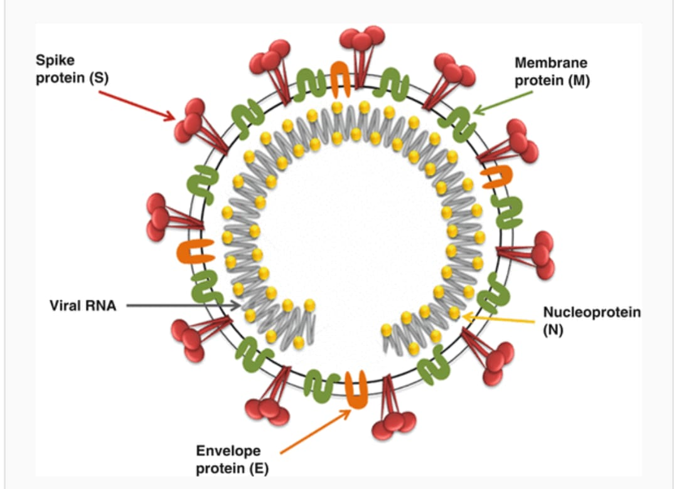
The Spike proteins is a type 1 membrane proteins containing receptor binding domains, cleavage site and cytoplasmic tale. It is involved in the attachment of the virus to the host cell. Virus neutralizing and Hemagglutination inhibition antibodies are formed against the first third of the NH3 (amino end) of the spike proteins
E-protein is a small membrane protein involved in the assembly of the virus. M-protein spans the envelope protein 3times with a protein of amino group end exposed on the outer surface of the virus. N-proteins forms the RNA genome and interacts with M and E protein for virus assembly.
www.poultryconsultantfirm.com

Slide 13
Among all the protein S1 gene of Spike protein have more varied structure it has three Hyper variable ( HVRs) regions. In which base pairs of nucleotides repeat. These regions exist in first 395 amino acids region of the S1 subunits. So any changes in amino acids with in the S1 protein result in formation of new serotype.
Acute emergence of IB variants is due to lack of proofreading by RNA dependent RNA polymerase (RD RP) that introduces mutation into the viral genome during replication; variations at genetic level is also introduced by specific template switching mechanism used by corona virus that leads to genetic recombination. The gene order of IBV is 5’-replicase-S-E-M-N-UTR-3’, where in the UTR covers untranslated regions. Furthermore, replicase is a viral enzyme (RNA polymerase) that is used during genome replication. (where 5’,3’ means 5 and 3 prime).
Susceptibility:
Virus is killed at 60°C (30 minute), pH of 3 when treated with acid. This enveloped virus is sensitive to Ether, chloroform, Formalin, Beta propiolactone.
www.poultryconsultantfirm.com

Slide 14
Pathogenicity:
Infection is initiated via the respiratory tract regardless of the tissue tropism of the virus. Respiratory strains replicate in epithelial cell of different respiratory organ like nasal turbinates, trachea, air Sacs, Lungs, Hadrian gland. Being a respiratory virus it increases susceptibility to other respiratory pathogen, E-Coli, MG-MS, ND, AI.
Nephropathogenic strains usually hit young birds of less than 3 weeks of age. Cause severe nephritis and high mortality. Mortality rate becomes even high in the presence of high dietary calcium, high animal byproducts proteins and during cold season.
Reproductive strains replicate in the reproductive tract and causes damages to it during early age. Some strains also cause infection of low severity in digestive tract. Some strain like QX and Q1 causes proventriculitis.
All ages are susceptible, however early life of chickens in more susceptible to nephropethogenic and genital tract strains, however birds become resistant to these strain with increase in age. In contrast to APMV1 and influenza virus pathogenicity not depend on cleavage site of amino acid motif but depend on geographic region.
www.poultryconsultantfirm.com

Slide 15
Transmission
Horizontal Transmission: Horizontal transmission occur by inhalation and ingestion by direct contact of infected to successtible. Indirect transmission includes the transmission of virus by contaminated visitors, clothing, shoes, tools, trucks. After infection highest concentration of the virus and peak severity is observed on 3-5 days. Then titers of the virus start dropping and even become undetectable by PCR on 10 days post infection in the respiratory tract.
During the chronic stage of disease virus is detectable in intestinal tract for a longer time of 2-7 months according to some authors, than from respiratory tract also from vaccinated flocks. There may occur re_excretion of virus. Following T-cells suppression by cyclosporine (immune suppression treatment or any disease) or at the onset of lay or peak production.
Possible explanation of long term isolation or re-excretion of the virus is the continued cross infection with in the flock. Continual excretion of the virus at the levels below the detection levels of tests usually persist in organs like cecal Tonsils and kidney mainly.
Reactivation occur by treatment with cyclosporine or re infection due to contact with infected feces when protection level has decrease up to a certain level.
www.poultryconsultantfirm.com

Slide 16
Vertical Transmission: there is no vertical transmission of the disease reported yet.
Incubation Period: incubation period is as short as 1-3 days.
Immunity
Innate Immunity: complementary system consists of a protein called Mannose Binding Lectin (MBL), that attaches to S1 unit of Spike protein and prohibits its attachment to the host cell in the Tracheal tissues.
Active Immunity: MHC class-1 restricts CTL (Cytotoxic T-lymphocytes) response so there occurs initial elimination of virus from Lungs and kidney in the acute phase of infection (than these are captured by IgG, IgM).
Humoral Immunity: First antibody appears on 9-10 days, there is a clear correlation between the circulating antibodies and the level of protection against egg production drop in case of any field challenge.
www.poultryconsultantfirm.com

Slide 17
Immuno Suppression
If there is an attack of IBV during first 8 days of chicken’s life, prior to IB vaccination. There is no appropriate response to IB vaccination throughout the life.
Diagnoses
Diagnoses should be made on the basis of signs, symptoms and postmortem lesion.
For diagnoses through laboratory, tracheal swabs, tracheal tissue is preferred during first week of infection. In a case disease has passed first week samples from kidney, Cecal Tonsils are preferred. It should be kept in mind that vaccine virus may also be found persisting in Cecal Tonsils. While sampling a large flock, samples should be taken from both diseased and healthy looking birds.
Different other methods used for IBV diagnoses are HI, VN, Immunofluorescence, PCR.
www.poultryconsultantfirm.com

Slide 18
Serology
Elisa, immunofluorescence and AGP test can bind antibodies to group specific antigens, Elisa is used most commonly. Commercial kits are available that can detect (IgG) after one-week of infection.
AGP can detect IgM and can be used during first two-week post infection. HI test is not preferred for IBV because sensitivity of the case may suffer by this method.
IBV should be different from ND, ILT, AI, SHS and Infectious Coryza.
Vaccination
Both live and inactivated vaccines are available.
In live vaccination we use M41, H120, H55 as Massachusetts serotype. MA5+IB4/9I protectotype combination is well being used in different countries of the world. It is better to use killed vaccine of IB variants rather than live vaccines. It should be preferred to use killed vaccines having local variant strains established locally rather than using killed vaccines containing standard serotype such as MASS and CONN, it will give better protection.
www.poultryconsultantfirm.com

Slide 19
Despite the potential negative effect of the MDA on the efficacy of live vaccination on first day live vaccines by spray method in hatchery are being practiced routinely and with good efficacy too.
No IB vaccines yet has been in ovo because any IB vaccine used in ovo has the potential to reduce the hatchability to an unacceptable level, as IBV is rapidly changing virus, so it is very difficult to develop a vaccine against each and every new emerging strains. So vaccine in combination as protectotype are being applied in the field.
Several studies have shown that live IBV, ND, ILT and SHS virus might interfere with each other replication, humoral response and induced low level of protection when administered together are in relatively short intervals from each other.
During Mass application (Spray, aerosol, drinking water) of live vaccines there are present a lot of evidences in which vaccine virus changed into virulent virus by back passage in chickens, by continued circulation of the vaccine virus, at the farm causing a rolling infection, which is result of poor vaccination procedures during which a lot of birds remain unvaccinated, also by uses of fractional doses has been associated to enhancing cyclic infection in a flock and an increase in vaccine associated virulance.
www.poultryconsultantfirm.com

Slide 20
Treatment
There is no specific treatment as it is respiratory virus, so a lot of other bacteria’s can infect the respiratory tract so use antibiotics against secondary bacterial infection, decrease the protein level of the diet also. Use of electrolytes to compensate the acute loss of sodium and potassium due to nephritis may result helpful. Use sodium or potassium citrate or carbonate salt form.
Current Field Observation
1). During a study in Italy most commonly used protectotype IB Ma5 +IB4/9I was analyzed against field challenge of QX strains.
According to Europe pharmacopoeias, the test of evaluated IB vaccine protection is considered valid if the challenge virus is isolated from no less than 80% of the control group and also vaccine is considered effective if the challenge virus is isolated from less than 20% of vaccinated birds. The genetic relationship at amino acid level between QX IBV and Ma5 strain was 77.1% and between QX IBV and IB 4/9I was 81%, Shows not very good similarity at amino acid and genetic level.
www.poultryconsultantfirm.com

Slide 21
Despite the low level genetic homology in the SI gene protein between the vaccine and the challenge strain, there found good protection against the QX strain, the reason for this could be the presence of local immunity of the upper respiratory tract that reduces replication of the challenge virus after giving by the oculonasal route. Also immune response directed to epitopes involved in the protective immunity might not be fully detected by HI test. Despite extensive differences in S1 protein, there are epitopes in common between different strains of IBV which play a major role in protective immunity.
www.poultryconsultantfirm.com

Slide 22
Results of Virological Examinations
Data presented as number of IBV-positive birds/number of birds in group / Challenge by QX Strain
Group | Trachea | Kidney | Ovary/Oviduct
1:SPF vaccinated chickens | 0/12 | 0/12 | 0/12
2: SPF unvaccinated Chickens | 12/12 | 11/12 | 10/12
3: Vaccinated Broilers | 6/12 | 0/12 | 1/12
4: Unvaccinated Broilers | 12/12 | 12/12 | 12/12
5: SPF chickens + Broiler (Control Group) | 0/6 | 0/6 | 0/6
Infectious bronchitis HI geometric mean antibody titre (log2 base) 21 days after the second vaccination (day of challenge) Log2 HI antibody titre (mean ± standard deviation) / Antigen used are MA5 and IB4/9I
Group | M41 | 4/9I | 624/I | IT-02 | QX
1: SPF vaccinated chickens | 4.92±1.08 | 5.33±0.88 | 3.66±0.77 | 3.16±0.57 | 3.33±0.49
2: SPF unvaccinated chickens | 0.00 | 0.00 | 0.00 | 0.00 | 0.00
3: Vaccinated Broilers | 4.16±0.83 | 4.50±1.00 | 3.33±0.65 | 3.00±0.42 | 3.25±0.45
4: Unvaccinated Broilers | 0.00 | 0.00 | 0.00 | 0.00 | 0.00
www.poultryconsultantfirm.com

Slide 23
2). During a study in Pakistan in December 2016, by NARC 905 samples are tested for IBV out of these 358 was isolated as MASS type (39%), 461 were isolated as 4/9I (51%), 90 samples were isolated as different variants. During the study a unique isolate was isolated that was not neutralized by antisera of M41-4/9I-D274-D1466 so identified as a distinct serotype. This serotype is named as PAK-973 (KX 013102-NARC/973-Pakistan-2015). It showed maximum homology of 93% with indian IBV variant (KF360 983-23/B/2008-india, India/PDRC/Pone/9/99) at amino acid level and similarity of 72% with MA5 and similarity to 4/9I was 75%.
www.poultryconsultantfirm.com

Slide 24
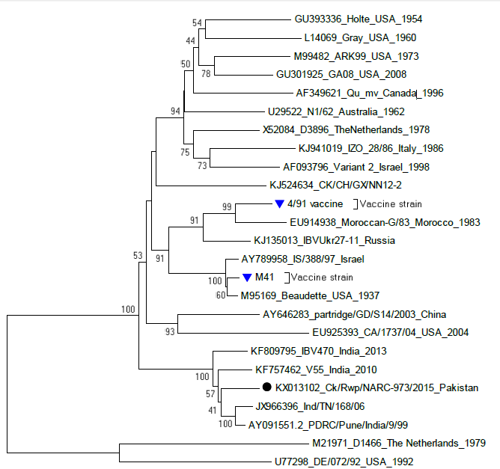
Fig: Phylogenetic tree showing spike glycoprotein and inter-relationship of IBV isolates. The Pakistani isolate are highlighted in black square and vaccines strains highlighted in blue triangle.
www.poultryconsultantfirm.com

Slide 25
3). During a study in china 2012-15 among 206 strains about 25% isolates isolated were QX, 12% were TW-1 and 10% 4/9I. The similarity between the QX isolates at amino acid and Nucleotide level was 91.3% and 92% respectively. However, similarity at amino acid and nucleotide level with commonly used vaccine strains like Ma5, IB4/9I, H120, H52, M41 was only 85% and 85.7% respectively.
4). In another study in Indonesia Amjad and Jones found IB4/91 strains to be as enterotropic than pneumotropic as because of its prolong persist in cecal tonsil compared to trachea.
5). In another study in Belgium IB coinfection with 4/9I, QX and MASS strains has also been reported.
Cavanagh reported that as low as 5% difference in SI gene would result in poor cross protection this fact increases the potential of IBV causing infection despite of active vaccination protocol at commercial level. Basically vaccine based on a certain serotype or genotype would be able to protect vaccinated birds against homologous challenge efficiently.
www.poultryconsultantfirm.com

