Slide 1
Avian Adenovirus Infections
A adenovirus cause different disease like HPS, IBH, AGE, EDS.
Classification
Adenovirus belong to the family Adenoviridae. There are present 5 generas of which 3 generas hit birds. These 3 generas are
1). Aviadenovirus (Group-I) 2). Siadenovirus (Group-II)
3). Atadenovirus (Group-III)
Nucleotide identity values between Aviadenovirus species might be low as 33% whereas between FADV species is up to 75%.
www.poultryconsultantfirm.com

Slide 2
Genus Aviadenovirus
Fowl Adenovirus has 5 strains like A, B, C, D, E and 12 serotype like 1, 2, 3, 4, 5, 6, 7, 8A, 8B, 9, 10, 11.
Strain A (FADV-A)- Serotype 1 causes AGE (Avian Gizzard Erosions).
Strain C (FADv-C) Serotype 4, 10 causes HPS.
Strain D (FADV-D) Serotype 2, 3, 9, 11 causes IBH.
Strain E (FADv-E) Serotype 6, 7, 8A, 8B causes IBH.
Strain B (FADv-B) –Serotype 5 causes……………..
Duck Adenovirus B (DADV-B2)
Falcon Adenovirus A (FaADV - 1)
Goost Adenovirus A (GoADV-A)
Pigeon Adenovirus A (Pi ADV-A)
Turkey Adenovirus B (T ADV-1, T ADV -2 )
www.poultryconsultantfirm.com

Slide 3
Genus Atadenovirus
Duck Adenovirus A (DADV-1, EDS)
Genus Siadenovirus
Rapitor Adenovirus –A (RADV-1).
Turkey Adenovirus –A (T ADV-3) {Hemorrhage (Turkey) enteritis}.
Marble Spleen (Pheasants).
Splenomegaly (Chicken).
www.poultryconsultantfirm.com

Slide 4
Signs and Symptoms
IBH: Sudden onset of mortality that reaches to peak on 3 to 4 day then start decreasing 8th day it may continue to 2 to 3 weeks. Morbidity rate is low. Birds are ruffled feathers having crouching position and die within 48 hours or may recover. Mortality rate may reach up to 30% , high mortality are in birds with age less than 3 weeks and in meat producing birds disease IBH may occur during first week of life. In young chicken disease usually occur because of vertical transmission. Studies show that immune suppression caused by IBD and CAV facilitate FADV. IBH sometimes may occur because of triggering factor of aflatoxins.
HPS: Clinical signs are very similar to IBH. However, mortality is much more high and may reach up to 80%, mortality may also be seen in mature birds.
AGE: Poor growth and uniformity with increased weekly mortality up to 0.2% and poor laying performance is related to AGE. With AGE sometimes pancreatitis, Hepatitis, Cholecystitis and cholangitis is observed.
FADV should also be considered as multi factorial disease. If there is vertical transmission of FADV then it may cause poor hatchability also.
www.poultryconsultantfirm.com

Slide 5
Post Mortem Lesions
IBH: Pale, Friable and swollen livers small white foci and ecchymotic or petechial Hemorrhages may present. Swollen kidney with glomerulonephlitis. There is atrophy of the bursa and thymus, Aplastic bone marrow and hepatitis are also there. Broilers are more susceptible with high mortality due to severe motabilitic unbalance due to defective pancreas and distraction of liver.
HPS: lesions are same with higher severity. There is an accumulation of clear, straw colored fluid in the pericardial sacs. Pulmornaryedema, swollen discolored liver, enlargement of kidneys, petechial hamargers are present on liver and heart. Necrosis pymerays, ascites may also be noticed, atrophy of thymus and bursa.
AGE: Distended gizzard with hemorrhagic fluid and black patchy erosions with in the koilin layer pancreatitis and gizzard erosions.
www.poultryconsultantfirm.com

Slide 6
History
Aviadenovirus was first discover in 1949.
Economics Significances
HPS, IBH, AGE causes high morbidity and mortality poor FCR.
Public Health
There is no known Public Health significance.
www.poultryconsultantfirm.com

Slide 7
Morphology
FADV in non-enveloped DNA virus with size of 70-90nm in diameter. The virion consists of 252 capsomeres that surround 60-65 micrometers core in diameter. Out of these 252 capsomeres 240 capsomeres are Hexon type and 12 are Penton type. There are present two fiber like projections called Gene fibers on each penton capsomeres. These fibers are equal in length in all strains as these arise from single RNA transcription. However, the length of these fibers is not equal in FADV-A and FADV-C. These fibers have great importance as these are involved in the determination of virulence of the strain thus formation of virus neutralization antibodies. There are present 10 structural proteins and 11 non-structural proteins.
Ultra structural studied demonstrate the accumulation of the virus inside the nucleus of infected cells.
www.poultryconsultantfirm.com

Slide 8
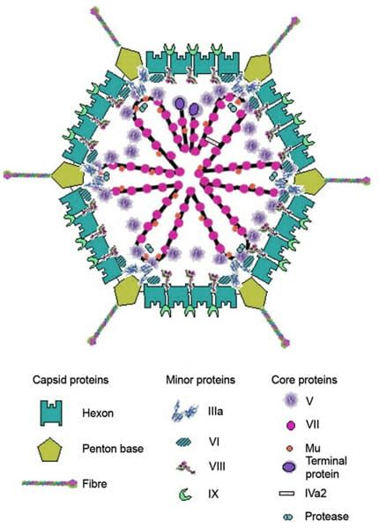
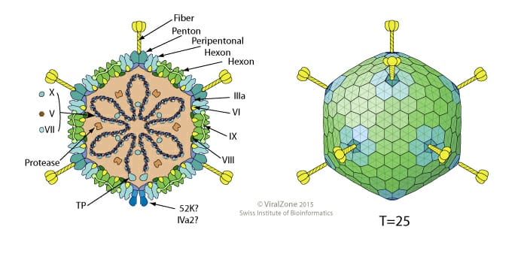
www.poultryconsultantfirm.com

Slide 9
Susceptibility to Chemical and Physical Agents
Virus is susceptible to pH lower than 3 and higher than 10, temperature of 60°C for 30 minutes and formaldehyde.
Being non-enveloped virus not susceptible to Ether, Chloroform, Phenol and Alcohol.
Age of Susceptibility
Age lower than 5 weak in susceptible to IBH and HPS. In matured birds it affects hatchability.
www.poultryconsultantfirm.com

Slide 10
Transmission
Vertical transmission is important in the spread of FADV and consequently in induction of disease in field.
FADV has the tendency to remain latent and undetected during rearing. Reduced hatchability is one of the outcome of natural infection with FADV.
Horizontal Transmission occur mainly by feces, virus excretion depends upon virus strain and age of the bird, intermittent excretion may also be considered.
Other routes of transmission are contaminated dust, egg trays, Trolleys, Visitors (Particularly for FADV-4).
It is not uncommon to isolate two or even three strains from one bird indicating that there is little cross protection between different serotype despite the presence of high level of antibodies against a specific single serotype.
www.poultryconsultantfirm.com

Slide 11
Excretion of the virus commonly re-occur at peak production that is because of stress associated with production and increased level of sex Harmons at that time that cause reactivation of the virus, which ultimately ensure maximum egg transmission to the next generation. Virus is present in feces, tracheal and nasal mucosa, kidneys, intestine and cecal tonsils therefore virus could be transmitted in all excretion, however maximum excretion occurs through feces.”
Virus may also be present in the semens causing a potential risk where AI is being practiced.
www.poultryconsultantfirm.com

Slide 12
Incubation Period
Depending upon age of the birds and route of infection it may be as short as 24 to 48 hours.
Virus Replication
Replication involved 2 steps
1). Step.1 virus enter into the nucleus of the cell then there is formation of so called Early (E) Proteins as a result of Transcription and translation.
2). As a 2nd step early protein redirects the cellular function by facilitating the replication of the virus DNA to form so called Late (L) Protein by Transcription and Translation.
Which is involved in the formation of structural protein of the virus. Assembly of the virus is completed in the nucleus. After good viral papulation nucleus burst virus is released into the cytoplasm and then cell burst after wards.
www.poultryconsultantfirm.com

Slide 13
Diagnosis
Real time PCR is being used for the diagnosis of FADV. specimens of choice are feces, Cecal tonsils, pharynx, Kidney and liver. In birds without lesions Cecal tonsils, liver and Pancreas are required organs.
Primers that detect individual serotypes can be developed and FTA papers (FTA Card) can be used for preservation and transportation as a source of viral DNA.
Serology
Some Aviadenoviruses can hemagglutinate rate and shape erythrocytes therefore HI is not preferred method for serology. Serum neutralization test, ELISA can be used for detection of type specific antibodies. Recombinant and no-structural protein 30K and 100K can be used to differentiate between infected and vaccinated birds. Hexon protein can be used to detect homologous antibodies with good sensitivity. The presence of humoral antibodies gives no indication of the state of local immunity at mucosal surfaces.
www.poultryconsultantfirm.com

Slide 14
Immunity
Aviadenoviruses have common group specific antigen. Which is distinct/different from that of Siadenovirus, Atadenovirus. Following infection or vaccination birds developed serotype specific antibodies that are detectable after one week and reaches at peak after 3 weeks.
After primary infection bird remain protected to re-infection up to 7 to 8 weeks.
Virus excretion can occur even in the presence maternal antibodies and humoral antibodies following a natural route of infection. Short lived local immunity mainly provides protection against re-infection while circulating antibodies mainly protect against invasion of internal organs. With regards to protection neutralizing antibodies are not solely responsible for protection.
www.poultryconsultantfirm.com

Slide 15
Vaccination
In the diseased birds sometime heterologous serotype are isolated in addition to homologous serotype vaccine strain that show the lack of cross protection between these serotype.
Contrary to this inactivated oil emulsion FADV-4 vaccine induces a high level of protection against various serotypes, not only in vaccinated/challenged SPF birds but also in broiler originated from vaccinated breeders.
Autogenous vaccines produced locally also sometime gives good result against local strain.
IBH: complete protection can be obtained in progenies successfully up to 50 weeks of age with grandparents are vaccinated with FADV-D, FADV-E at 10th week and 17th week of age. Using an adjuvant, polyphosphazene in combination with avian Beta defensin-II can enhance the antibody response and also up regulation of selected cytokines in the spleen even after in Ovo vaccination of a killed FADV-8B.
www.poultryconsultantfirm.com

Slide 16
HPS: During sever attack of HPS, disease was controlled successfully by using autogenous vaccines prepared from livers of effected birds in Pakistan in recent past. Subsequently vaccines prepared on tissue culture or in embryonated eggs were developed. Protein fiber/Penton base of FADV-4 expressed as recombinant protein induced as high level of protection against HPS. However only 40% of protection was achieved with 100K non-structural protein.
AGE: contrary to IBH, HPS maternal antibodies seem to be less protective in preventing AGE. However, a non-virulent FADV-I strain administered live vaccine orally to day old chicken induced complete protection. Following challenge after 3 weeks later with a virulent field strain.
IBD and CIAV can potentiate the pathogenicity of FADV so the first step must be to control these viruses to overcome FADV.
The adenovirus Hexon is the major capsid protein that contain type, group and subgroup specific antigenic determinant against which antibodies are produced. Neutralizing antibodies produced against the type specific epitopes provide protection. But there is limited data available about the contribution of individual epitope and the duration of the protection.
www.poultryconsultantfirm.com

Slide 17
Scientific research
➡ In UAF during 2005 EDS strain 127 is isolated in Pakistan. EDS virus grow well on duck embryo.
➡ FADV is generally opportunistic and regulated by Immunosuppressive disease like REV, CIAV, ALV-A.
➡ Mostly FADV 2 and 11 from strain D + 8a, 8b FADV from strain E are involved in IBH.
➡ Autogenous, killed, live vaccine are available.
➡ Chicken derived 127 virus strain and duck derived D11-JW-032 replicate well in CEL and produces high titres than duck derived D11-JW-012 and D11-JW-017.
➡ All strains with all genotypes found in hungry. Strain SR48 (FADV 2) is closely related (90%) to AF 509846 (FADV 11). Strain FADV B, genotypes 5 like TR22/STRAIN 340 causes IBH, lameness and swelling at tarsal joint.
➡ In China HPS major attacks occurred during 2015 is b/c of strain C, FADV-4.
➡ During 2012 cases of HPS raised in chicken, live ND Lasota virus was checked by PCR and found positive for FADV that caused immunes spread of FADV.
➡ In Korea b/t 2007-2010 HPS cases caused by strain 4 and IBH is caused by serotypes 8b (E), 11 (strain D). In all 39 cases IBD and CIAV were also isolated that caused Immunosuppression.
www.poultryconsultantfirm.com

