Slide 1
Atadenovirus
(Egg Drop syndrome)
Classification
Egg drop syndrome of chickens (EDSV) belong to the family Adenoviridae, Genas Atadenovirus (DADV-I), EDS, 127, AAV-2.
EDS of chicken should not be confused with egg drop syndrome of duck, DADV-I which is caused by a virus called “Flavivirus”.
www.poultryconsultantfirm.com

Slide 2
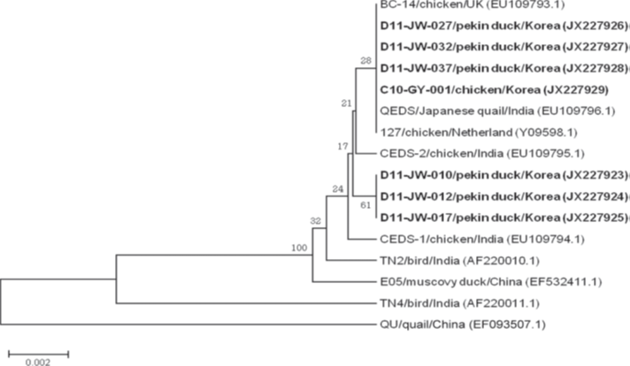
www.poultryconsultantfirm.com

Slide 3
EDS has one Serotype however there are four Geno Type listed as
European Genotype
United Kingdom Genotype
Australian Genotype
Indian Genotype
A study in 2004 on Japanese isolates of EDSV from chicken showed no evidence of changes of virus after two decade circulating in the chickens.
www.poultryconsultantfirm.com

Slide 4
Signs and Symptoms
Following experimental infection signs of the disease are observed between 7 to 17 days PI.
First sign is loss of egg shell pigment then there is thinning of shells, soft shell eggs and shell less eggs.
Thinned shelled eggs are often rough with sand paper like texture or had a granular roughening of the shell at one end of the egg. If abnormal eggs are separated and discarded, then there is no effect on fertility and hatchability. Fall in egg production is very rapid and extends over several weeks. Outbreak may last for 4-10 weeks with decrease in production up to 40%, though there is compensation in later stage of production phase eventually ends with 10-16 less hatchable eggs per hen. If infection occur due to reactivation of latent virus (vertical transmission) the fall of production occur from 50% to peak production.
If birds are infected on first day, then on production they produce impaired albumen quality and small sized eggs vs normal albumen and normal size of egg if effected on late stages during egg production. If latent virus is activated (Vertical Transmission) then onset of eggs is delayed accompanied by lower peak productions with small clinical episode of classic EDS.
There may be inappetence, dullness and transient diarrhea due to the secretions from the oviduct mixing with dropping.
Oral infection of susceptible day old chicks results in increased mortality in first week of life, EDSV do not cause clinical disease during growing phase in the field, there is no mortality in flocks that receive virus vertically.
www.poultryconsultantfirm.com

Slide 5
Post Mortem Lesions
Mucosal edema and exudate in the pouch shell gland commonly seen within 7 to 17 days PI. Mild splenomegaly, Flaccid ovules, inactive ovaries, atrophied oviduct and uterine edema are observed. Unlike to aviadenovirus and siadenovirus EDSV does not replicate in the intestinal epithelium and presence of the virus in the feces in laying birds is due to contaminated feces with oviduct secretion.
History
Firstly, described in 1976 and became commonly referred as EDS’76. No antibody was found in chicken up to 1974, but antibody was common in ducks. However, EDSV isolated from normal duck and showed optimal growth in duck cell, so common hypothesis is that EDSV is introduced to chicken through contaminated vaccines, that’s why its species name is Duck atadeneovirus Type-A and its strain name is duck adenoviruses Type-I (DADV-1 or EDSV).
www.poultryconsultantfirm.com

Slide 6
Economic Significances
Decrease in production both in hatching and table eggs.
Public Health Significances
There is no known Public Health Significances.
Morphology
It is a typical adenovirus difference in only in size which is 75-80nm in case of EDS.
Susceptibility to Chemical and Physical Agents
Same as that of typical adenoviruses.
Virus Replication
EDSV replicates in Epithelial cell of infundibulum, Shell Gland, Isthmus, Nasal Mucosa and Spleen.
www.poultryconsultantfirm.com

Slide 7
Transmission
EDSV outbreak is divided into three forms.
1). Classical 2). Enzootic (Endemic) 3). Sporadic
Classical Outbreak: it occurs through vertical transmission although number of infected embryos were low, later lateral spread of virus was efficient. In many cases virus remains latent and birds develop HI antibodies until the flock reaches toward peak from 50% production, virus start excreting. At this stage there occur rapid lateral spread due to multiple foci of infection.
Enzootic (Endemic): sometime virus become established in some areas. This is commonly associated with egg packing station and contaminated egg trays. This is probably due to the abnormal and normal shelled eggs produced during the period of virus growth in the shell gland, virus is thus present on the exterior and interior of the eggs. Feces are also excreting virus (though this shedding is intermittent) that contaminate the eggs. Spread can also be occurring when birds are transported through inadequately cleaned trucks, also by moving unused feed from contaminated farm to another clean farm. Vaccination through contaminated needles from viremic birds, can also spread the disease in Enzootic form of spread, lateral spread of virus is slow and intermittent taking up to 11 weeks to spread in cage house, however faster on litter bedding.
Sporadic Form: This spread occurs from wild ducks, geese and other wild birds by contaminated water or droppings. Sporadic form sometime lead for establishing endemic infection.
www.poultryconsultantfirm.com

Slide 8
Diagnosis
Major hurdle in diagnosis is the absence of clinical signs in effected birds, slow spread of infection, transient nature of virus and associated lesions make difficult to select birds suitable for diagnostic purpose.
Virus is isolated from abnormal eggs by quantitative PCR which is not much in practice, so we usually conduct serological diagnosis.
We can feed the abnormal eggs to healthy birds and at the first appearance of abnormal eggs, hens are slaughtered and specimen should be taken from pouch shell gland to isolate the virus.
Virus Isolation
Most sensitive method for EDSV isolation is inoculation of infected allantois fluid in embryonating duck or geese eggs derived from flock free of EDSV infection or duck and geese cell culture.
www.poultryconsultantfirm.com

Slide 9
Differential Diagnosis
Shell less, Soft shell and thin shelled eggs are characteristic of EDSV, however misshapen and rigid eggs are not the feature of EDSV. In vertically transmitted flock attack of the disease usually occur around peak egg production, birds either remain unable to reach standard production level or there is sudden drop of daily egg production.
One can face the difficulty of visualizing the shell less eggs as they may be trampled into the litter or may be consumed by the birds. To counter that, inspect the flock immediately before the lights are ON in the morning.
www.poultryconsultantfirm.com

Slide 10
Serology
HI, Elisa, SN, DID and IFA all these test maybe used for serology purpose, Elisa is most effective and adopted method.
Many vertically effected birds do not develop antibodies during growing period. Antibodies only become apparent immediately following appearance of clinical signs so a negative serological test at 20th week even give no guarantee of freedom from vertical transmission of the virus.
www.poultryconsultantfirm.com

Slide 11
Vaccination
Oil based inactivated vaccines used between 14-16 weeks of age give good protection that lasts for up to one year. HI titers of 8-9 Log2 are expected in unaffected and 12-14 log2 titers in previously exposed flocks are observed. After vaccination titers start building on 7th day and reaches the peak on 5th week. Properly vaccinated flocks are fully protected against field challenges and improper vaccinated flock give shedding after field exposure to EDSV.
As intervention strategies take breeder flock from grandparent which is free of EDSV.
Virus is quite resistant so lateral spread should be controlled by keeping the eggs trays and egg boxes clean and uncontaminated. Separate needles are used for vaccination of effected and unaffected birds. Similarly, isolate workers and even isolate hatcheries to control the spread of the virus. If separate hatcheries are not possible then use isolated Setters and Hatchers for infected flocks.
Live virus not introduced into breeding hens because of the potential shedding of the virus in the progency, this is the reason that European pharmacopeias requires all avian viral vaccines tested to ensure freedom from EDSV.
www.poultryconsultantfirm.com

